Slide 1
CSS
Using CSS
Getting into CSS
CSS - Session - 1
Notes:
Cascading Style Sheets (CSS) is a stylesheet language used to describe the presentation of a document written in HTML or XML (including XML dialects such as SVG, MathML or XHTML). CSS describes how elements should be rendered on screen, on paper, in speech, or on other media.

Slide 2

What does CSS stand for?
Notes:
🍐 This is a Pear Deck Text Slide
🍐 To edit the type of question, go back to the "Ask Students a Question" in the Pear Deck sidebar.

Slide 3
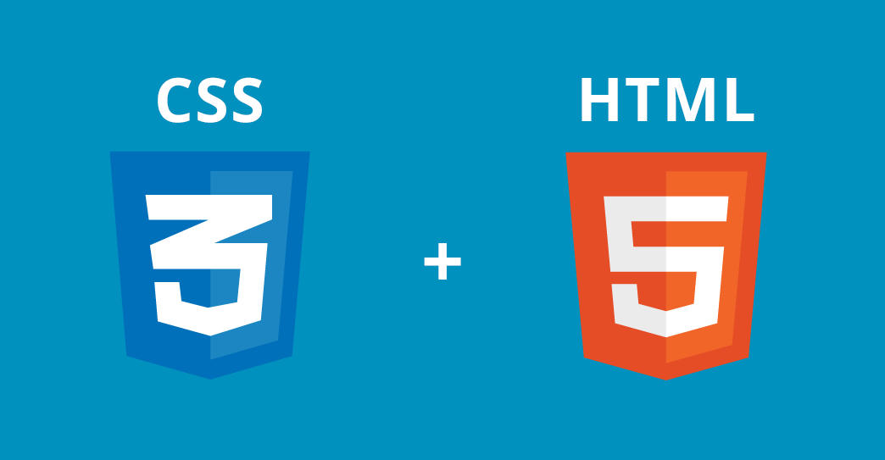
Introduction
to CSS
Notes:
CSS is a cornerstone technology of the World Wide Web, alongside HTML and JavaScript.

Slide 4
Table of Contents
What is CSS?
History of CSS
Why Use CSS
CSS Syntax

Slide 5

What is CSS?
Notes:
CSS is among the core languages of the open web and is standardized across Web browsers according to W3C specifications.

Slide 6
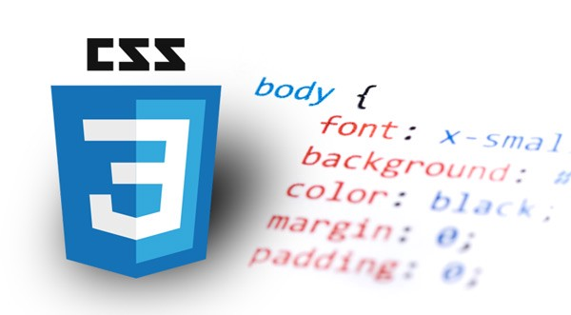
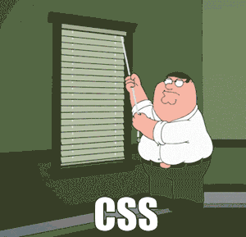
What is CSS?
Cascading Style Sheets
Notes:
CSS (Cascading Style Sheets) is the code that styles web content.
—-------------------
a small waterfall, typically one of several that fall in stages down a steep rocky slope.
arrange (a number of devices or objects) in a series or sequence.

Slide 7

CSS is a programming language.
Notes:
🍐 This is a Pear Deck Multiple Choice Slide. Your current options are: A: True, B: False,
🍐 To edit the type of question or choices, go back to the "Ask Students a Question" in the Pear Deck sidebar.
CSS neyin kısaltmasıdır?

Slide 8

What is CSS?
CSS helps elements how to be displayed on the web.
CSS files are the external style sheets which consists of the styles for HTML file.
Notes:
Like HTML, CSS is not a programming language. It's not a markup language either. CSS is a style sheet language. CSS is what you use to selectively style HTML elements.
The name cascading comes from the specified priority scheme to determine which style rule applies if more than one rule matches a particular element.
—---------------------
Cascading Style Sheets, fondly referred to as CSS, is a simply designed language intended to simplify the process of making web pages presentable. CSS allows you to apply styles to web pages. More importantly, CSS enables you to do this independent of the HTML that makes up each web page.
CSS is easy to learn and understood but it provides powerful control over the presentation of an HTML document.

Slide 9
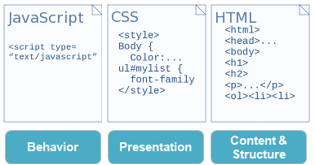
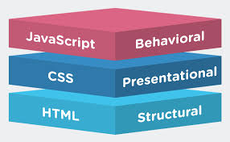
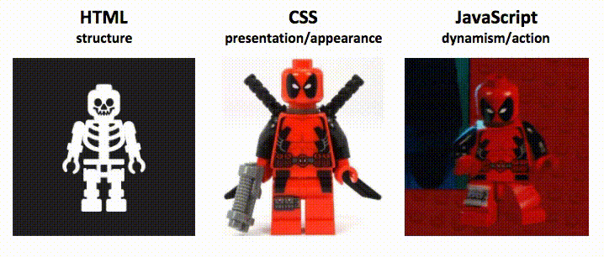
What is CSS?
Notes:
CSS is designed to enable the separation of presentation and content, including layout, colors, and fonts. This separation can improve content accessibility, provide more flexibility and control in the specification of presentation characteristics, enable multiple web pages to share formatting by specifying the relevant CSS in a separate .css file which reduces complexity and repetition in the structural content as well as enabling the .css file to be cached to improve the page load speed between the pages that share the file and its formatting.

Slide 10
History of CSS
Notes:
open link and tell them to read by theirselves.
https://www.w3.org/Style/CSS20/history.html

Slide 11

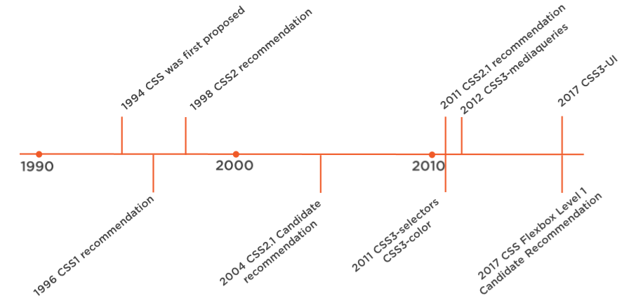

History of CSS
Notes:
According to Wikipedia, the birth of CSS is largely credited to Norwegian Håkon Wium Lie, who back in 1994 sought to create a universal standardised style sheet for the World Wide Web.
In 1996 CSS becomes to allow the user to select font style and size and change the colour of the text and background.
In 1998 CSS2 gains capabilities that allows the user to design page layout.
In 1999 CSS2 starts to allow the user to create presentations from documents and to select from a wider range of fonts including those from Google and Typecast. Uniquely, CSS3 allows the user to incorporate rounded borders and use multiple columns. CSS3 is considered to be easier to use (when compared to CSS2) because it has different modules
—-----------------------
The first CSS specification to become an official W3C Recommendation is CSS level 1, published on December 17, 1996. Håkon Wium Lie and Bert Bos are credited as the original developers.^{[41][42]} Among its capabilities are support for
Font properties such as typeface and emphasis
Color of text, backgrounds, and other elements
Text attributes such as spacing between words, letters, and lines of text
Alignment of text, images, tables and other elements
Margin, border, padding, and positioning for most elements
Unique identification and generic classification of groups of attributes
The W3C no longer maintains the CSS 1 Recommendation.
CSS 2 includes a number of new capabilities like absolute, relative, and fixed positioning of elements and z-index, the concept of media types, support for aural style sheets (which were later replaced by the CSS 3 speech modules)^{[44]} and bidirectional text, and new font properties such as shadows.
CSS level 2 revision 1, often referred to as "CSS 2.1", fixes errors in CSS 2, removes poorly supported or not fully interoperable features and adds already implemented browser extensions to the specification.
Unlike CSS 2, which is a large single specification defining various features, CSS 3 is divided into several separate documents called "modules". Each module adds new capabilities or extends features defined in CSS 2

Slide 12
Why Use CSS
Notes:
In short, using CSS ensures that your web pages are consistent.

Slide 13
Why Use CSS
CSS is used to style your web pages. Using CSS you will be able to put out pages with much less work, that load much faster, and will be easy to update and print!
Notes:
keywords:
less work
much faster
easy to update

Slide 14
CSS Syntax
Notes:
A CSS rule consists of a selector and a declaration block.

Slide 15
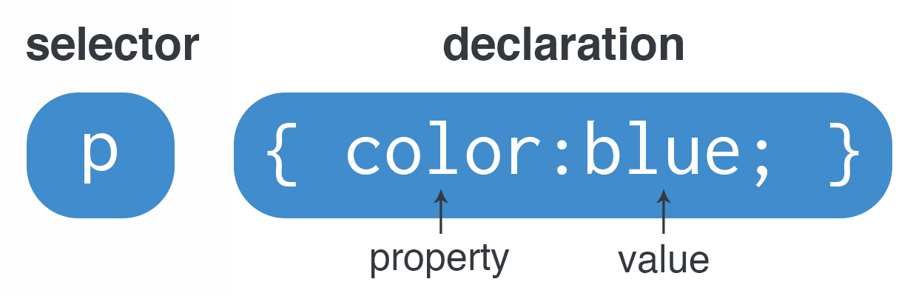
CSS Syntax
Notes:
CSS works by associating rules with HTML elements. These rules govern how the content of specified elements should be displayed. A CSS rule contains two parts: a selector and a declaration. This rule indicates that all p elements should be shown in blue color. Selectors indicate which element the rule applies to. The same rule can apply to more than one element if you separate the element names with commas.
Declarations indicate how the elements referred to in the selector should be styled. Declarations are split into two parts (a property and a value), and are separated by a colon.
CSS on the slide selects paragraph text, setting the color to blue.
continue from link:
https://developer.mozilla.org/en-US/docs/Learn/Getting_started_with_the_web/CSS_basics#anatomy_of_a_css_ruleset

Slide 16
Basic CSS rule consists of a selector, a declaration and a style.
Notes:
🍐 This is a Pear Deck Multiple Choice Slide. Your current options are: A: True, B: False,
🍐 To edit the type of question or choices, go back to the "Ask Students a Question" in the Pear Deck sidebar.

Slide 17
Use of CSS
Notes:
CSS can be added to HTML documents in 3 ways

Slide 18
Table of Contents
Inline CSS
Internal CSS
External CSS file
Multiple Styles and Cascade Rule
Notes:
The most common way to add CSS, is to keep the styles in external CSS files. However, because of easiness we can use inline and internal styles as well.

Slide 19
Inline CSS
Notes:
Inline CSS is used to style a specific HTML element.

Slide 20
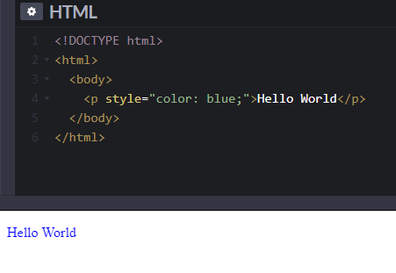
Inline CSS
For any single element in the HTML file can have inline styles. For inline styling, the style attribute is used.
Notes:
For this CSS style, you’ll only need to add the style attribute to each HTML tag, without using selectors.

Slide 21
Internal CSS
Notes:
Internal or embedded CSS requires you to add <style> tag in the <head> section of your HTML document.

Slide 22
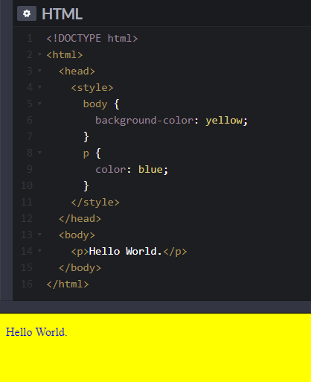
Internal CSS
For any single HTML file, internal styles can be used. The internal styles are written inside the <style> section of the HTML page.
Notes:
This CSS style is an effective method of styling a single page. However, using this style for multiple pages is time-consuming as you need to put CSS rules on every page of your website.

Slide 23
External CSS file
Notes:
With external CSS, you’ll link your web pages to an external .css file, which can be created by any text editor in your device (e.g., Notepad++).

Slide 24
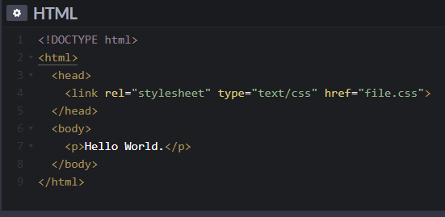
External CSS file
* The styles can be located in a different file, so with an external style sheet, the design of the website can be changed from this file.
* To include an external stylesheet, <link> element must be used as a reference to the external style sheet in the <head> section of the HTML page.
Notes:
The element can be used in an HTML document to tell the browser where to find the CSS file used to style the page. It is an empty element (meaning it does not need a closing tag), and it lives inside the element. It should use three attributes:
href This specifies the path to the CSS file (which is often placed in a folder called css or styles).
type This attribute specifies the type of document being linked to. The value should be text/css.
rel This specifies the relationship between the HTML page and the file it is linked to. The value should be stylesheet when linking to a CSS file.
An HTML page can use more than one CSS style sheet. To do this it could have a element for every CSS file it uses. For example, some authors use one CSS file to control the presentation (such as fonts and colors) and a second to control the layout.

Slide 25
Multiple Styles and Cascade Rule
Notes:
In CSS, style sheets cascade by order of importance. If rules in different style sheets conflict with one another, the rule from the most important style sheet wins.

Slide 26
Multiple Styles and Cascade Rule
* All styles which are applied to the same element will apply in the cascade order of rules.
* Inline styles have the top priority, then external and internal style sheets and finally browser default styles. So, an inline style will override external and internal styles and browser defaults.
Notes:
Author inline styles
Author embedded styles (aka: internal style sheets)
Author external style sheet
User style sheet
Default browser style sheet

Slide 27
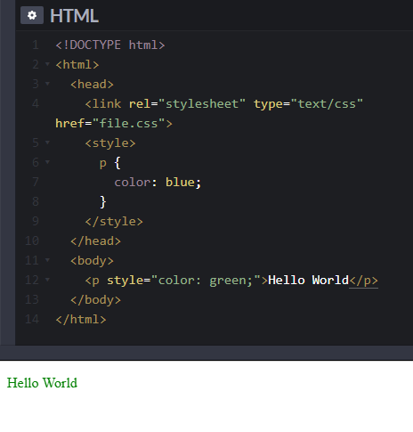
Multiple Styles and Cascade Rule.
* In the external style sheet, color of <p> is defined as red.
* In the internal style, color of <p> is defined as blue, and in the inline style green, where the browser default is black.
* In this example, the color of <p> element is green because of cascade rules.
Notes:
continue from slide.
!important:
https://developer.mozilla.org/en-US/docs/Learn/CSS/Building_blocks/Cascade_and_inheritance#!important

Slide 28
Which style has the lowest priority in CSS
Notes:
🍐 This is a Pear Deck Multiple Choice Slide. Your current options are: A: Browser default, B: External CSS file, C: Internal CSS, D: Inline CSS,
🍐 To edit the type of question or choices, go back to the "Ask Students a Question" in the Pear Deck sidebar.

Slide 29
Getting into CSS

Slide 30
Table of Contents
The Box Model
CSS Selectors
CSS Comments
Notes:
In CSS, selectors are patterns used to select the element(s) you want to style.
CSS comments are not displayed in the browser, but they can help document your source code.

Slide 31
The Box Model
1
Notes:
Let’s start with box model.

Slide 32
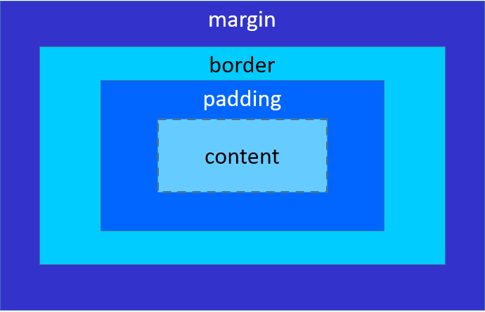
The Box Model
All elements in HTMl file is considered as boxes. The "Box Model" term is used to describe box that surrounds an element. It consists of: margins, borders, padding, and the content.
* Content: The content of the box.
* Padding: A transparent area around the content.
* Border: A border that around the padding and content.
* Margin: A transparent area around the border.

Slide 33
CSS Selectors
Notes:
CSS selectors define the elements to which a set of CSS rules apply.
https://developer.mozilla.org/en-US/docs/Learn/Getting_started_with_the_web/CSS_basics#different_types_of_selectors

Slide 34
CSS Selectors
CSS selectors are used to select HTML elements.
Notes:
CSS selectors are used to "find" (or select) the HTML elements you want to style.
We can divide CSS selectors into five categories:
Simple selectors (select elements based on name, id, class)
Combinator selectors (select elements based on a specific relationship between them)
Pseudo-class selectors (select elements based on a certain state)
Pseudo-elements selectors (select and style a part of an element)
Attribute selectors (select elements based on an attribute or attribute value)
I will explain the most basic CSS selectors in class.

Slide 35
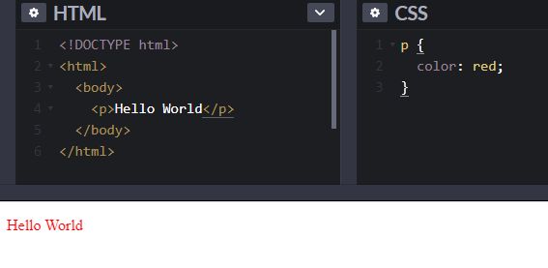
CSS Selectors
CSS element Selector
An element selector uses element name to select the HTML element.
Notes:
The element selector selects HTML elements based on the element name.

Slide 36
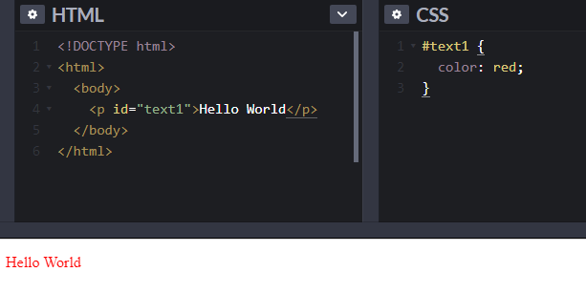
CSS Selectors
CSS id Selector
The id selector uses id attribute to select the element in HTML file.
The id of an element must be unique in a page. A hash (#) character is used to select an element with a specific id.
Notes:
The id selector uses the id attribute of an HTML element to select a specific element.
The id of an element is unique within a page, so the id selector is used to select one unique element!
To select an element with a specific id, write a hash (#) character, followed by the id of the element.

Slide 37
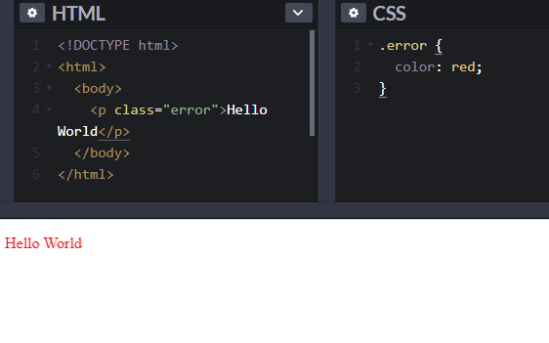
CSS Selectors
CSS class Selector
The class selector uses class attribute to select all elements of that class in HTML file.
A period (.) character is used to select elements with a specific class.
Notes:
The class selector uses class attribute to select all elements of that class in HTML file.
A period (.) character is used to select elements with a specific class.

Slide 38
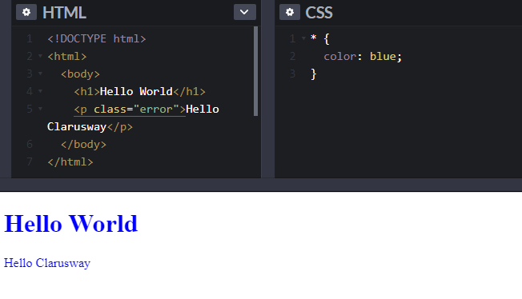
CSS Selectors
Universal Selector
The universal selector (*) selects all HTML elements on the page.
Notes:
The universal selector (*) selects all HTML elements on the page.

Slide 39
CSS Comments
Notes:
Comments are used to explain the code, and may help when you edit the source code at a later date.

Slide 40
CSS Comments
The browser does not display comments, but with comments, we can place warnings, descriptions and other notes.
CSS Comments can add the text between /* and */ characters.
/* Single-line comment */
/* This is a
Multi-line comment */
Notes:
Comments are ignored by browsers.
A CSS comment is placed inside the <style> element, and starts with /* and ends with */:

Slide 41
CSS Borders
Notes:
The CSS border properties allow you to specify the style, width, and color of an element's border.

Slide 42
Table of Contents
Border Properties
Border Style
Border Width
Shorthand
Border Radius

Slide 43
Border Properties
1

Slide 44
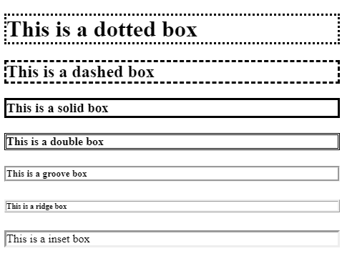
Border Properties
The CSS border properties define;
* width,
* the style,
* color of an element's border.

Slide 45
Border Style
2
Notes:
The border-style property specifies what kind of border to display.

Slide 46
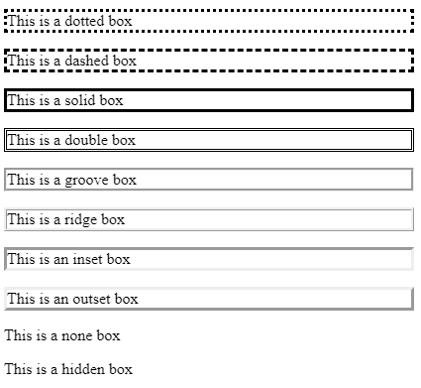
Border Style
The border styles are as follows:
dotted
dashed
solid
double
groove
ridge
inset
outset
none
hidden
Notes:
The following values are allowed:
dotted - Defines a dotted border
dashed - Defines a dashed border
solid - Defines a solid border
double - Defines a double border
groove - Defines a 3D grooved border. The effect depends on the border-color value
ridge - Defines a 3D ridged border. The effect depends on the border-color value
inset - Defines a 3D inset border. The effect depends on the border-color value
outset - Defines a 3D outset border. The effect depends on the border-color value
none - Defines no border
hidden - Defines a hidden border

Slide 47
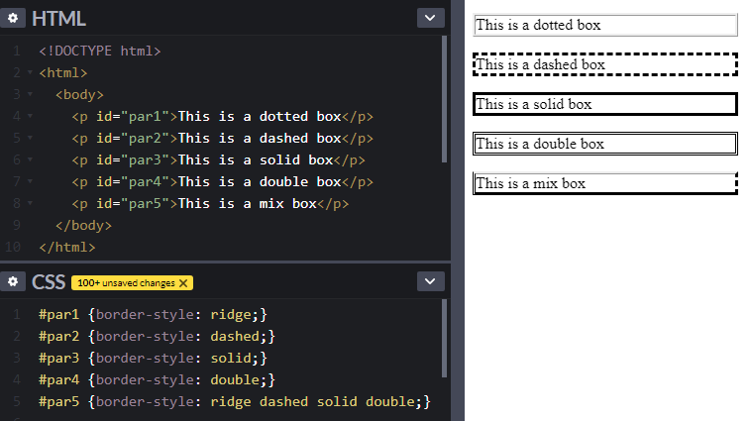
Border Style
border-style
The border-style property can have from one to four values (top border, right border, bottom border, and left border).

Slide 48
Border Width
3
Notes:
The border-width property specifies the width of the four borders.

Slide 49
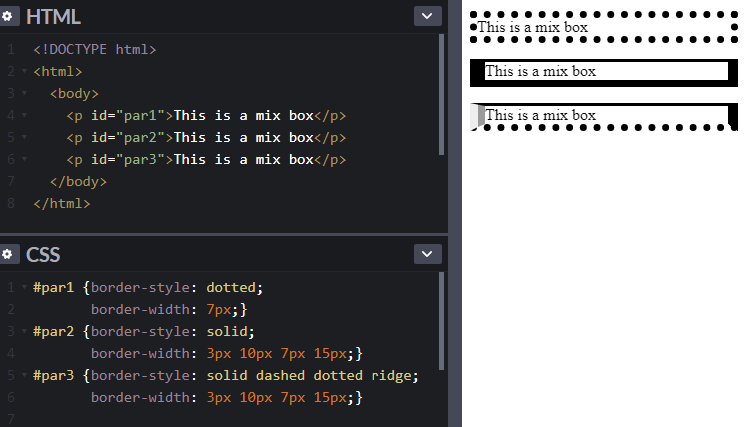
Border Width
border-width
The border-width property defines the width of the borders.
The border-with property can have from one to four values (top border, right border, bottom border, and left border).
Notes:
The width can be set as a specific size (in px, pt, cm, em, etc) or by using one of the three pre-defined values: thin, medium, or thick:

Slide 50
Border Color
3
Notes:
The border-color property is used to set the color of the four borders.

Slide 51
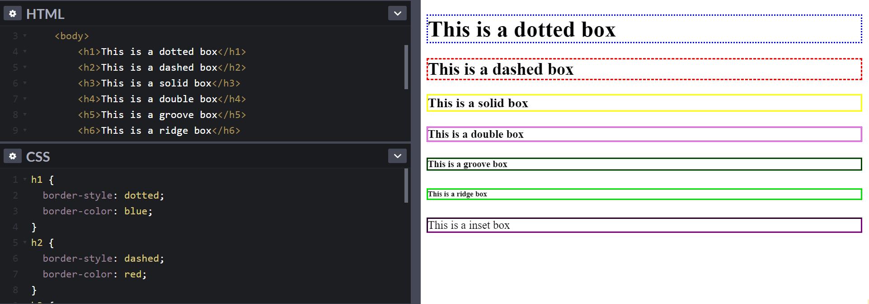
Border Color
border-color
The border-color property is used to set the color of the four borders.
Notes:
If border-color is not set, it inherits the color of the element.

Slide 52
Shorthand Property
To shorten the code, it is also possible to specify all the individual border properties in one property.
The border property is a shorthand property for the following individual border properties:
border-width
border-style (required)
border-color
border: 5px solid blue;
shorthand
Notes:
Values
<line-width>
Sets the thickness of the border. Defaults to medium if absent. See border-width.
<line-style>
Sets the style of the border. Defaults to none if absent. See border-style.
<color>
Sets the color of the border. Defaults to currentcolor if absent. See border-color.

Slide 53

Border-Radius
border-radius
The border-radius property is used to add rounded borders to an element
border-radius: 10px;
Notes:
The border-radius property is used to add rounded borders to an element:
p {
border: 2px solid red;
border-radius: 5px;
}

Slide 54
CSS Margin
Notes:
Margins are used to create space around elements, outside of any defined borders.

Slide 55
Table of Contents
Margin Property
Shorthand Property
Auto Value
Inherit Value

Slide 56
Margin Property
1
Notes:
With CSS, you have full control over the margins.

Slide 57
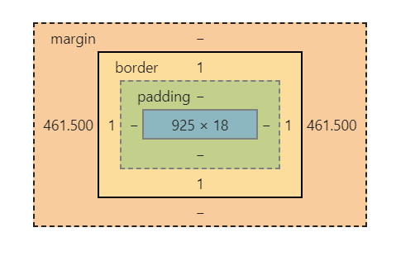
Margin Property
The margin property is used to create space outside of the borders of the element. There are 4 different properties for setting the margin for each side of an element:
* margin-top
* margin-right
* margin-bottom
* margin-left
Notes:
There are properties for setting the margin for each side of an element (top, right, bottom, and left).

Slide 58
Margin Property
Margin properties can have the following values:
auto: The length of the margin is calculated automatically.
-/+ numbers: Length of the margin is defined in px, rem, em, cm, etc.
%: Length of the margin is in % of the width of the containing element.
inherit: Length of the margin is inherited from the parent.

Slide 59
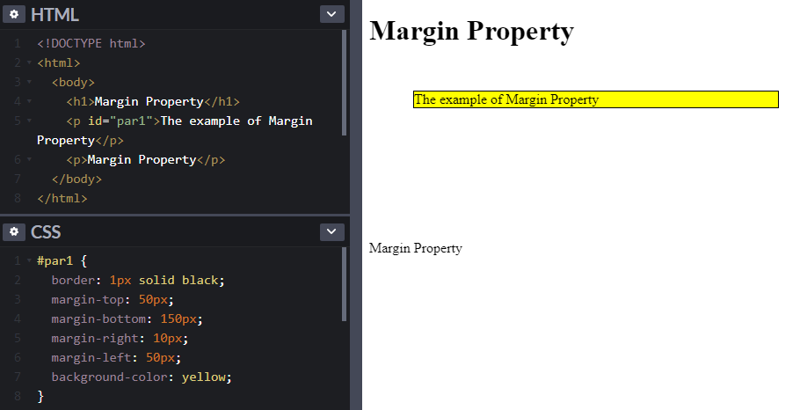
Margin Property
Margin Property
The margin property is used to create space outside of the borders of the element.

Slide 60
Shorthand Property
2

Slide 61
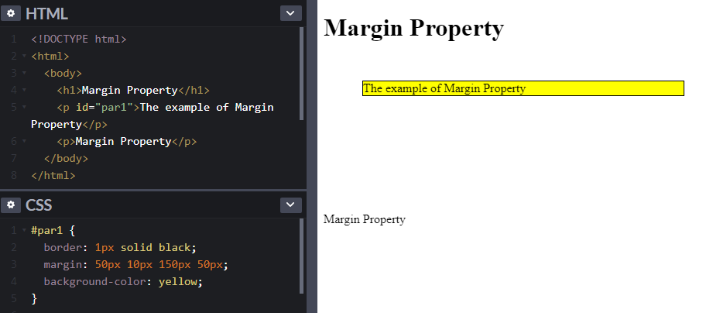
Shorthand Property
4 margin values
In this example, 4 margin values are used. The order of the margin values are: top margin-right margin-bottom margin-left margin.

Slide 62
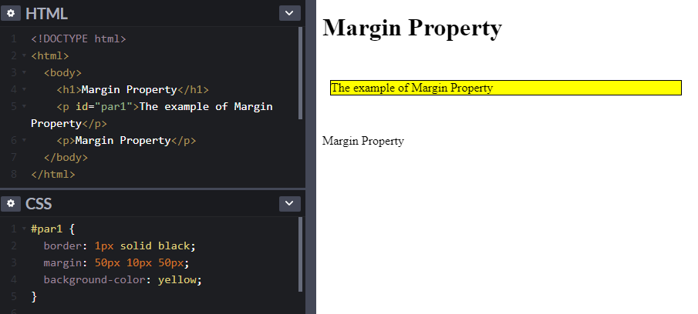
Shorthand Property
3 margin values
In this example, 3 margin values are used. The order of the margin values are: top margin-right/left margins-bottom margin.

Slide 63

Shorthand Property
2 margin values
In this example, 2 margin values are used. The order of the margin values are: top/bottom margins - right/left margins.

Slide 64
Auto Value
3

Slide 65
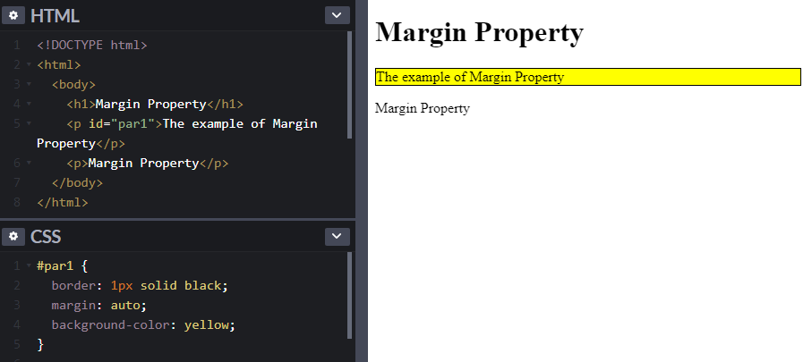
Auto Value
Auto Value
The margin property can be set to auto. The browser will calculate the margin and horizontally center the element.

Slide 66
Inherit Value
4

Slide 67
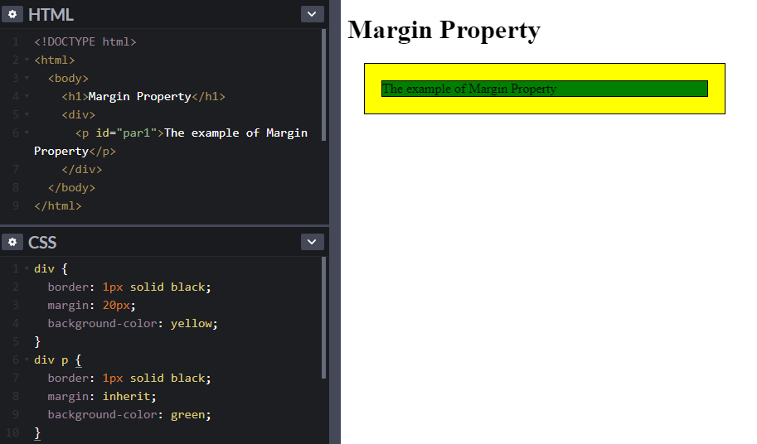
Inherit Value
Inherit Value
The margin of an element can be inherited from the parent element using inherit value.

Slide 68
CSS Padding
Notes:
Padding is used to create space around an element's content, inside of any defined borders.

Slide 69
Table of Contents
Padding Property
Shorthand Property
Inherit Value
box-sizing property

Slide 70
Padding Property
The padding property is used to define space between the element's content and the borders. There are 4 different properties for setting the padding for each side of an element:
* padding-top
* padding-right
* padding-bottom
* padding-left
Notes:
With CSS, you have full control over the padding.

Slide 71
Padding Property
Padding properties can have the following values:
length: Length of the padding is defined in px, rem, em, cm, etc.
%: Length of the padding in % of the width of the containing element.
inherit: Length of the padding is inherited from the parent.

Slide 72
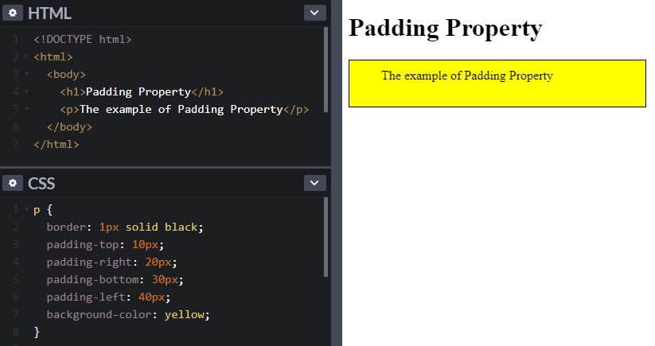
Padding Property
Padding Property
The padding property is used to define space between the element's content and the borders.

Slide 73
Shorthand Property
2

Slide 74
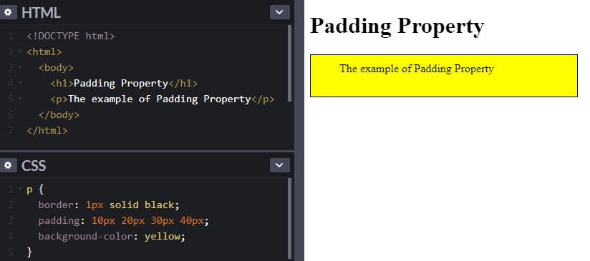
Shorthand Property
4 Padding values
In this example, 4 padding values are used. The order of the padding values are: top padding-right padding-bottom padding-left padding.

Slide 75
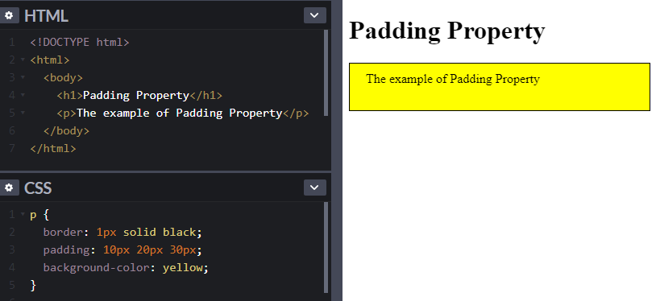
Shorthand Property
3 padding values
In this example, 3 padding values are used. The order of the padding values are: top padding-right/left paddings-bottom padding.

Slide 76
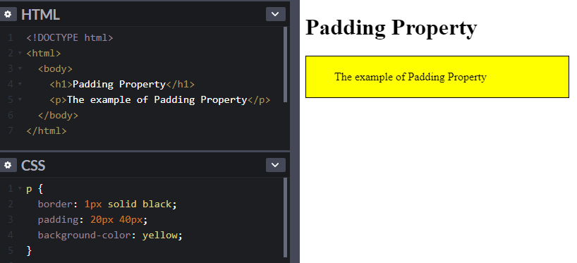
Shorthand Property
2 padding values
In this example, 2 padding values are used. The order of the padding values are: top/bottom paddings - right/left paddings.

Slide 77
Inherit Value
3

Slide 78
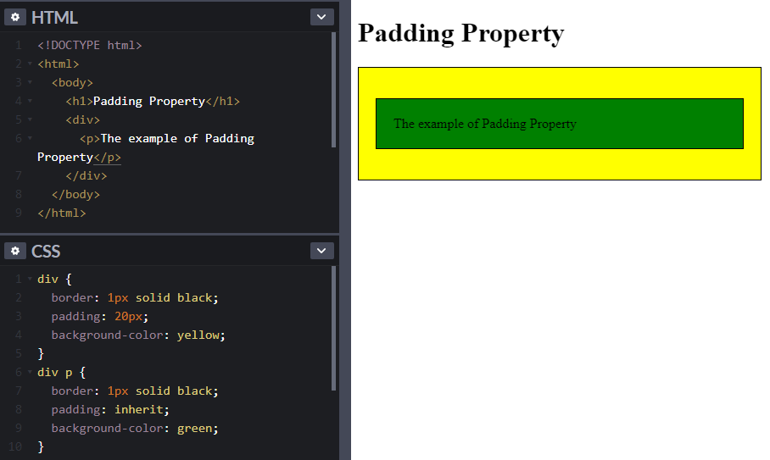
Inherit Value
Inherit Value
The padding of an element can be inherited from the parent element using inherit value.

Slide 79
box-sizing property
4
Notes:
The CSS box-sizing property allows us to include the padding and border in an element's total width and height.

Slide 80
box-sizing property
* The CSS width property specifies the width of the element's content area. The content area is the portion inside the padding, border, and padding of an element (the box model).
* If an element has a specified width, the padding added to that element will be added to the total width of the element. This is often an undesirable result.

Slide 81
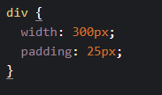
box-sizing property
* In the example below, the <div> element is given a width of 300px. However, the actual width of the <div> element will be 350px (300px + 25px of left padding + 25px of right padding)
* To keep the width at 300px, no matter the amount of padding, you can use the box-sizing property. This causes the element to maintain its width; if you increase the padding, the available content space will decrease.

Slide 82
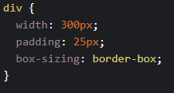
box-sizing property
* Use the box-sizing property to keep the width at 300px, no matter the amount of padding:

Slide 83
CSS Text
Notes:
CSS has a lot of properties for formatting text.

Slide 84
Table of Contents
Text Color
Text Alignment
Text Decoration
Text Transformation
Text Indentation
Letter Spacing
Line Height
Text Direction
Word Spacing
Text Shadow

Slide 85



Did you finish pre-class?
Notes:
Hard or Easy
Use this template to do a quick temperature check and self-reflection about the homework. You can learn which students might have struggled with the assignment and therefore might need more attention today.
🍐 This is a Pear Deck Draggable™ Slide.
🍐 To edit the type of question, go back to the "Ask Students a Question" in the Pear Deck sidebar.

Slide 86
Did you finish first Survey Form project?
Notes:
Hard or Easy
Use this template to do a quick temperature check and self-reflection about the homework. You can learn which students might have struggled with the assignment and therefore might need more attention today.
🍐 This is a Pear Deck Draggable™ Slide.
🍐 To edit the type of question, go back to the "Ask Students a Question" in the Pear Deck sidebar.

Slide 87
Text Color
1

Slide 88
Text Color
The color property is used to change the color of the text. The color is defined by one of the followings:
* color name: blue
* HEX value: #0000FF
* RGB value: rgb(0,0,255)
* RGBA value: rgba(0,0,255,1.0)
Notes:
Burda yazmadığımız ama bir özelliğimiz daha vardı neydi o? HSL → HUE SATURATION LIGHTNESS / BURADA YİNE ALPHA İLE KULLANAİBLİYORUZ.

Slide 89
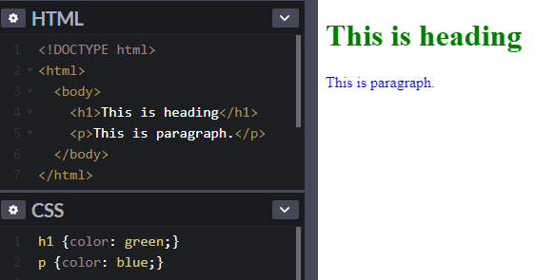
Text Color
Text Color
The color property is used to change the color of the text.

Slide 90
Text Alignment
2

Slide 91
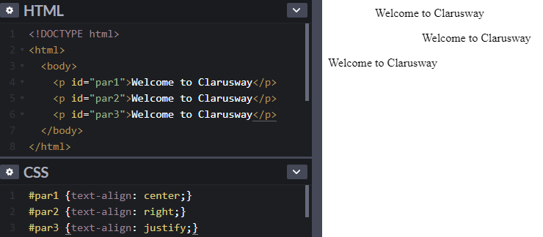
Text Alignment
Text Alignment
The text-align property is used to set the
horizontal alignment of a text.
A text can be aligned to left or right, centered, or justified.
Notes:
Metin hizalama özelliği, bir metnin yatay hizalamasını ayarlamak için kullanılır.
text-align: inherit; Bir de initial var, ki o da default value suna işaret eder.

Slide 92
Text Decoration
3

Slide 93
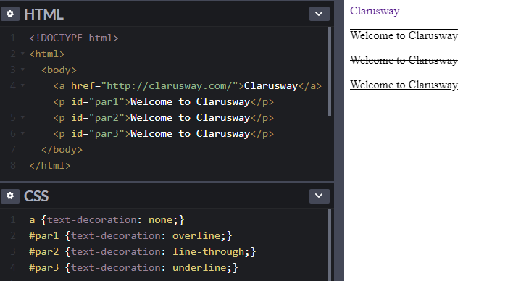
Text Decoration
Text Decoration
The text-decoration is used to define decorations for text.
text-decoration:none; is often used to remove underlines from links
Notes:
text-decoration-line (required) ---> overline underline
text-decoration-color ---> colors
text-decoration-style ---> solid, wavy, double, */

Slide 94
Text Transformation
4

Slide 95
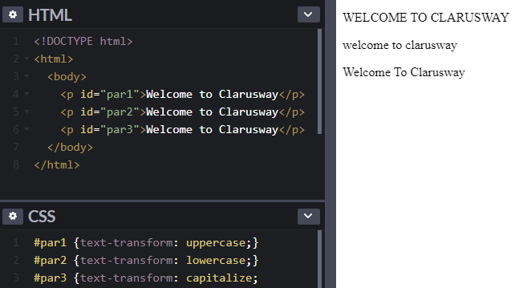
Text Transformation
Text Transformation
The text-transform property is used to turn text into uppercase or lowercase, or capitalize the first letter of each word:

Slide 96
Text Indentation
5

Slide 97
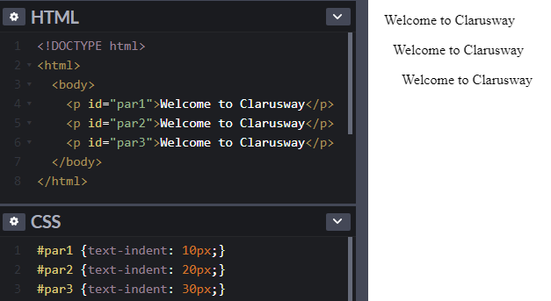
Text Indentation
Text Indentation
The text-indent is used to set indentation of the first line of a text.

Slide 98
Letter Spacing
6

Slide 99
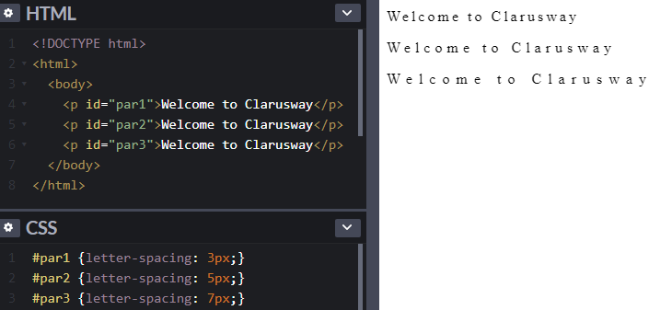
Letter Spacing
Letter Spacing
The letter-spacing is used to set the space between the characters in a text.

Slide 100
Line Height
7

Slide 101
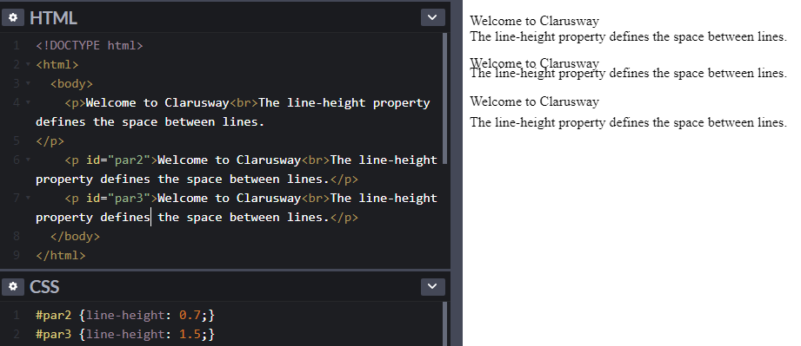
Line Height
Line Height
The line-height property is used to specify the space between lines.

Slide 102
Text Direction
8

Slide 103
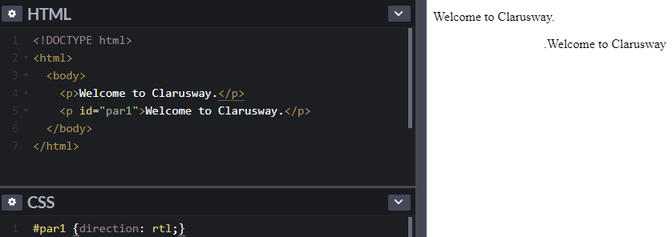
Text Direction
Text Direction
The direction is used to change the text direction of an element:

Slide 104
Word Spacing
9

Slide 105
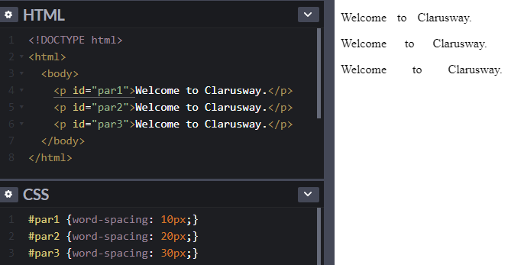
Word Spacing
Word Spacing
The word-spacing is used to specify the space between the words in a text.

Slide 106
Text Shadow
10

Slide 107
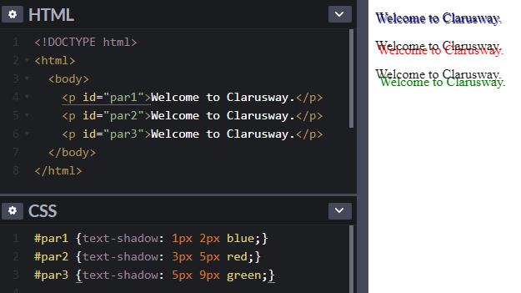
Text Shadow
Text Shadow
The text-shadow property adds shadow to text. In the example below: * first value specifies the position of the horizontal shadow, * second value specifies the position of the vertical shadow, * third value specifies the color of the shadow.
Notes:
text-shadow: h-shadow v-shadow blur-radius color|none|initial|inherit;

Slide 108
THANKS!

Slide 109
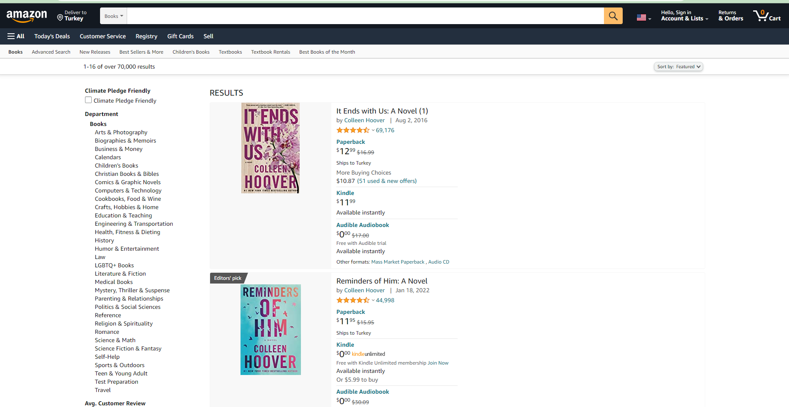

Slide 110
Books
Arts & Photography
Biographies & Memoirs
Business & Money
Calendars
Children's Books
Christian Books & Bibles
Comics & Graphic Novels
Computers & Technology
Cookbooks, Food & Wine
Crafts, Hobbies & Home
Education & Teaching
Engineering & Transportation
Health, Fitness & Dieting
History
Humor & Entertainment
Law
It Ends with Us: A Novel (1)
by Colleen Hoover | Aug 2, 2016
4.7 out of 5 stars
69,176
Paperback
$12.99
$16.99
Ships to Turkey
More Buying Choices
$10.87(51 used & new offers)
Kindle
$11.99
Available instantly
Audible Audiobook
$0.00
$17.00
Free with Audible trial
Available instantly
Other formats: Mass Market Paperback , Audio CD
https://www.amazon.com/s?bbn=283155&rh=n%3A283155%2Cp_n_feature_browse-bin%3A2656022011&dc&qid=1646500625&rnid=618072011&ref=lp_1000_nr_p_n_feature_browse-bin_0
Notes:
It Ends with Us: A Novel (1)
by Colleen Hoover | Aug 2, 2016
4.7 out of 5 stars
69,176
Paperback
$12.99
$12
.
99
$16.99
$16.99
Ships to Turkey
More Buying Choices
$10.87(51 used & new offers)
Kindle
$11.99
$11
.
99
Available instantly
Audible Audiobook
$0.00
$0
.
00
$17.00
$17.00
Free with Audible trial
Available instantly
Other formats: Mass Market Paperback , Audio CD
Books
Arts & Photography
Biographies & Memoirs
Business & Money
Calendars
Children's Books
Christian Books & Bibles
Comics & Graphic Novels
Computers & Technology
Cookbooks, Food & Wine
Crafts, Hobbies & Home
Education & Teaching
Engineering & Transportation
Health, Fitness & Dieting
History
Humor & Entertainment
Law

